Slide 1







Supply Chain

Slide 2



Our Team
Ahmed Harby
Mahmoud Mohamed
Yossef Ezzalden
Rania Hassan
Ghada Abdeen

Slide 3

CONTENT
01
Introduction
02
Database Design
03
DWH Design
04
ETL Process
05
Analyzing Data
06
Recommendation Actions

Slide 4

introduction

Slide 5
Introduction
Dataset Overview
This dataset provides a comprehensive view of the supply chain process by capturing key components such as orders, products, customers, stores, and sales transactions, shipping logistics. The structure of the dataset follows a star schema, allowing for easy analysis and insights into the flow of goods and services.
Sales: Records of sales transactions, including order details, product pricing, discounts, and total sales amounts.
Transactions: Information on order IDs, item codes, and financial metrics such as earnings and profit per order.
Customer Interactions: Data on customer profiles, including contact details, segmentation (e.g., Consumer, Corporate), and geographical locations.
Shipping Logistics: Insights into shipping times, including Real vs. scheduled delivery durations, shipping methods, and delivery status.
Product Management: Details on product IDs, names, descriptions, pricing, and availability status.

Slide 6
Introduction
Goals
Personalize Interactions: Use customer data to tailor marketing and enhance service.
Increase Revenue: Analyze sales data to refine pricing strategies, promotions, and sales tactics to boost overall revenue.
Evaluate Products: Assess product performance to guide inventory and development decisions.
Optimize Shipping: Improve shipping accuracy and reduce delays by analyzing Real vs. scheduled shipping times.
the project aims to leverage data-driven insights to drive improvements in operational efficiency, customer satisfaction, financial performance, product management, and market understanding.

Slide 7

Database Design

Slide 8
Database Design
Collecting the data
2. Understanding the data
3. Design enity relation diagram
4. Design the mapping
5. creating tables in SQL
6. Transfer the data to SQL

Slide 9

Design entity relation diagram
(ERD)

Slide 10
Design entity relation diagram (ERD)
We've broken down the data into groups of entities (such as orders,orderitem, products, customers, and Category) and how they relate to each other, making it easier to understand how the data is organized.:

Slide 11
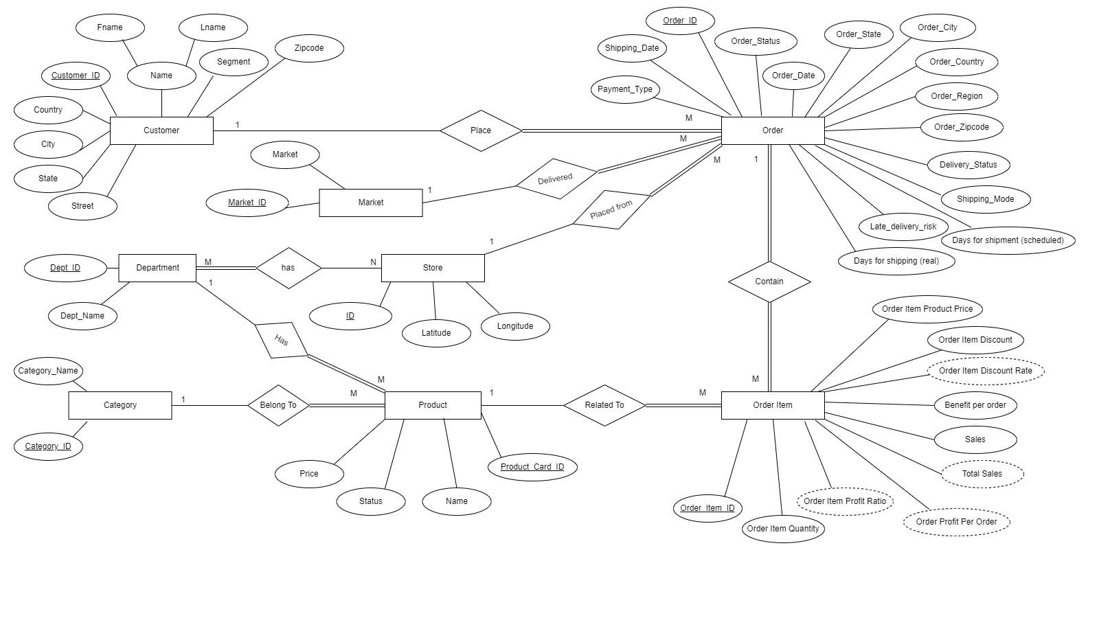
Design entity relation diagram (ERD)

Slide 12

Design Mapping

Slide 13
Design Mapping
Through Mapping we begin to collect relevant data and link it between different tables or entities in the database. It plays a very important role in organizing information, especially in the context of the supply chain.

Slide 14
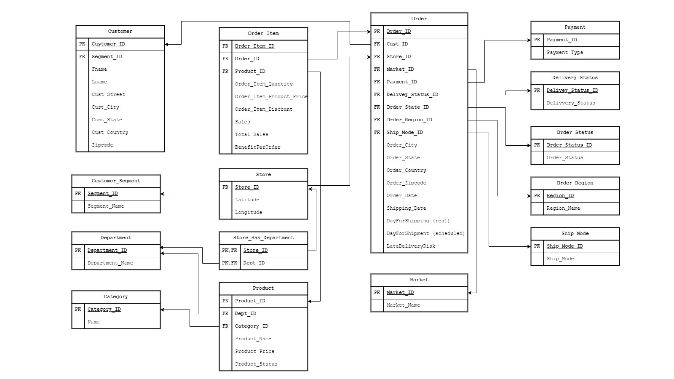
Design Mapping

Slide 15

Transfer data to SQL

Slide 16
Transfer data to SQL
By using SSIS we prefer to move data from data source (Excel files) to destination (database).

Slide 17
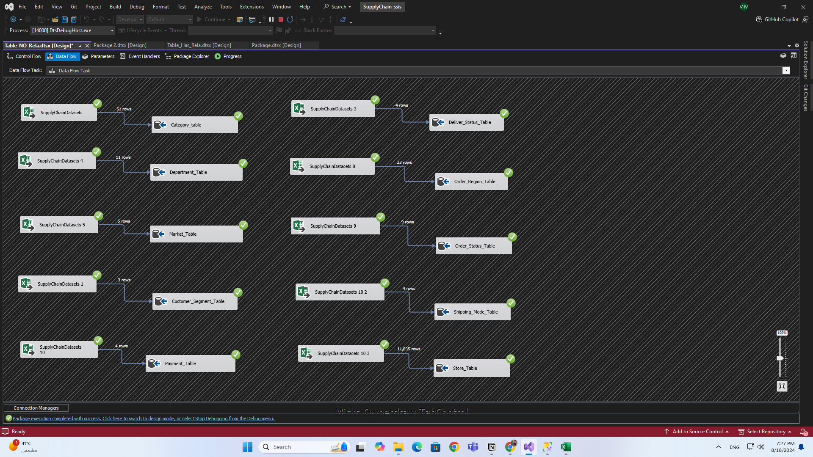
Transfer data to SQL
Example of transfer data :

Slide 18

DWH Design

Slide 19
DWH Design
By understanding the business first and then converting normalized tables in
a database into denormalized tables in a data warehouse through dimension
tables and a fact table. To meet the business needs of analysis for a later
period
Contains:
Facts: fact_sales
Dimention: Dim_Time , Dim_date , Dim_order , Dim_Store , Dim_product , Dim_Customer

Slide 20
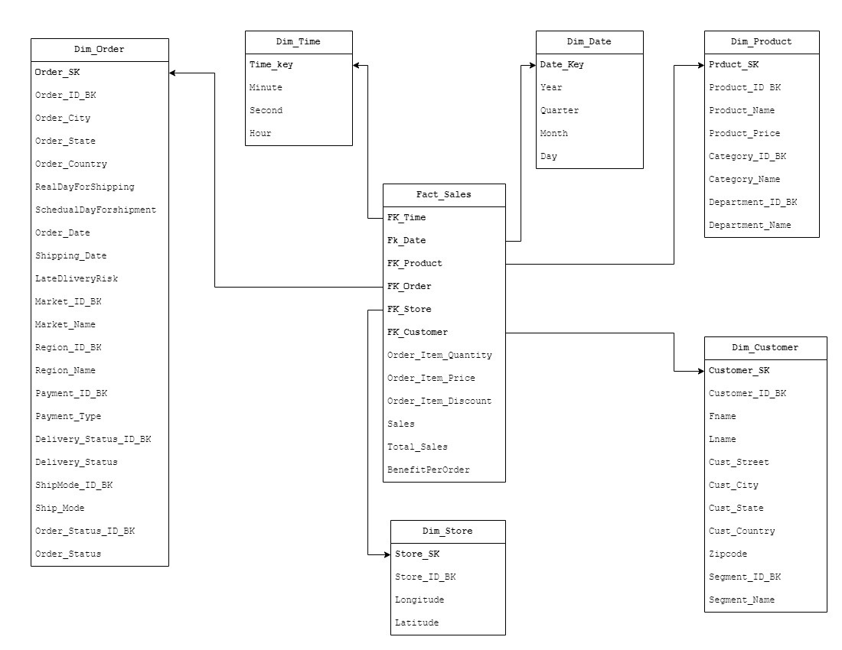
DWH Design
Identify dimension tables and fact tables:

Slide 21

ETL Process

Slide 22
ETL Process
Using SSIS to transfer data from database to data warehouse (Incremental
Load) taking into consideration the slowly changing dimension .

Slide 23
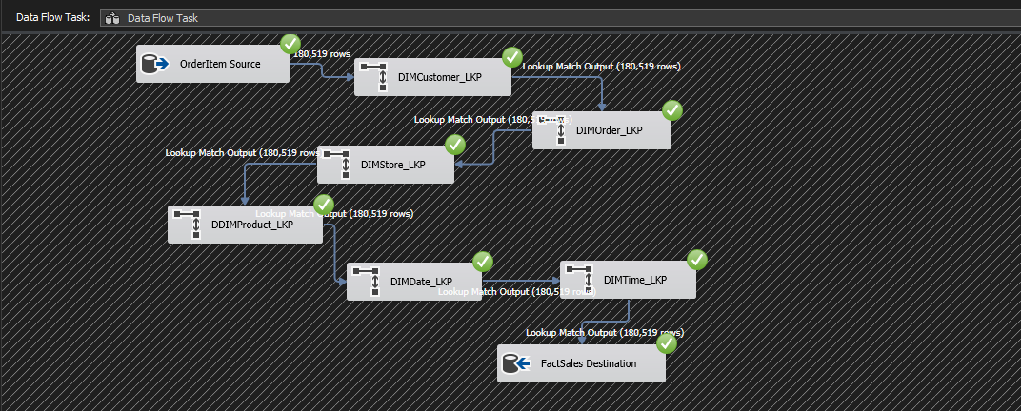
ETL Process
Example of transfer Fact Sales table :

Slide 24
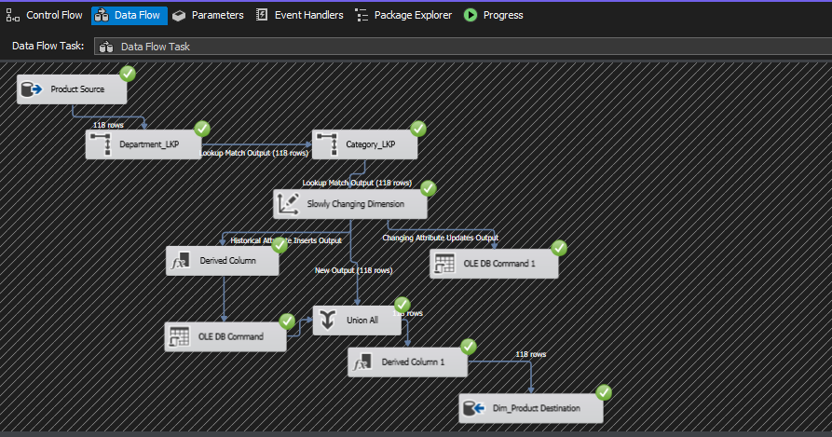
ETL Process
Another example of transfer DIm Product table :

Slide 25
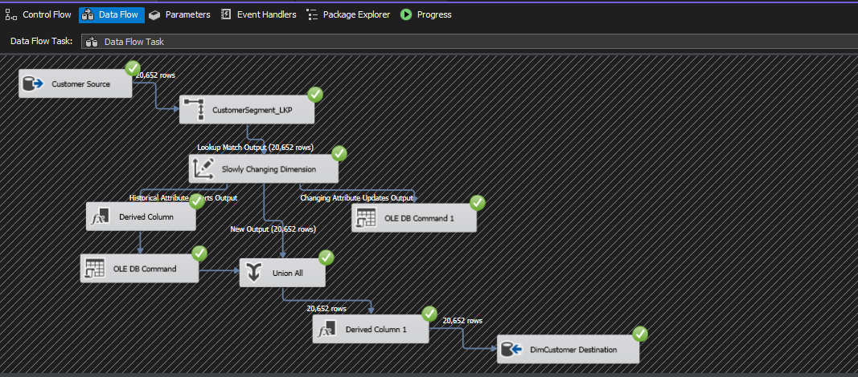
ETL Process
Another example of transfer Dim Customer table :

Slide 26

Analyzing data

Slide 27
Analyzing data
We can analyze data in multile ways , such as :
SSAS and SSRS
Visualization using Power BI
Visualization using Tableau
Visualization using Excel

Slide 28
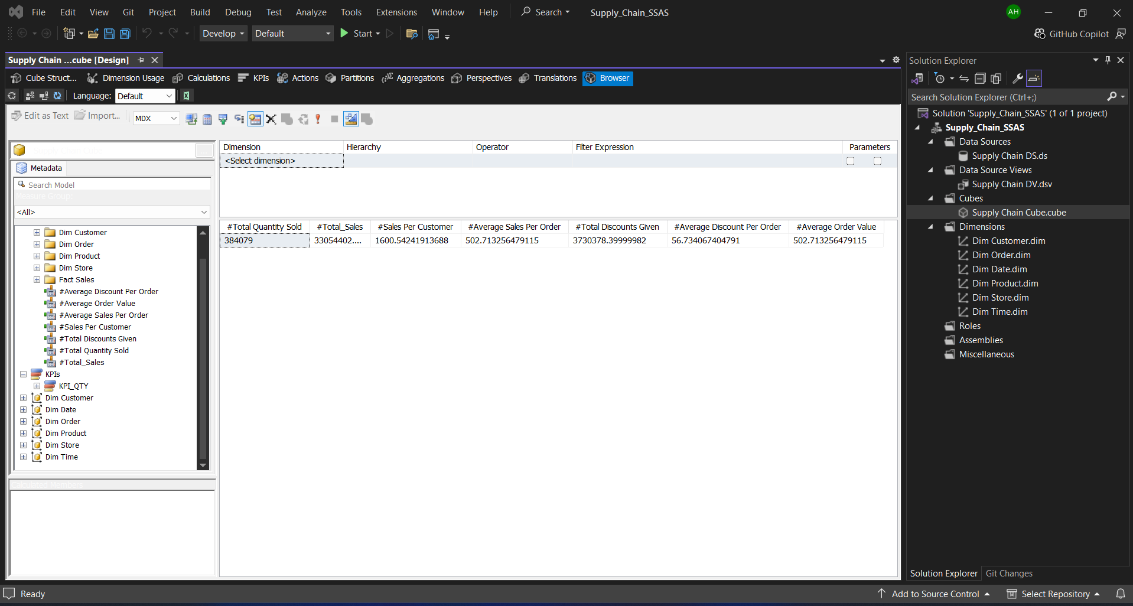
SSAS

Slide 29
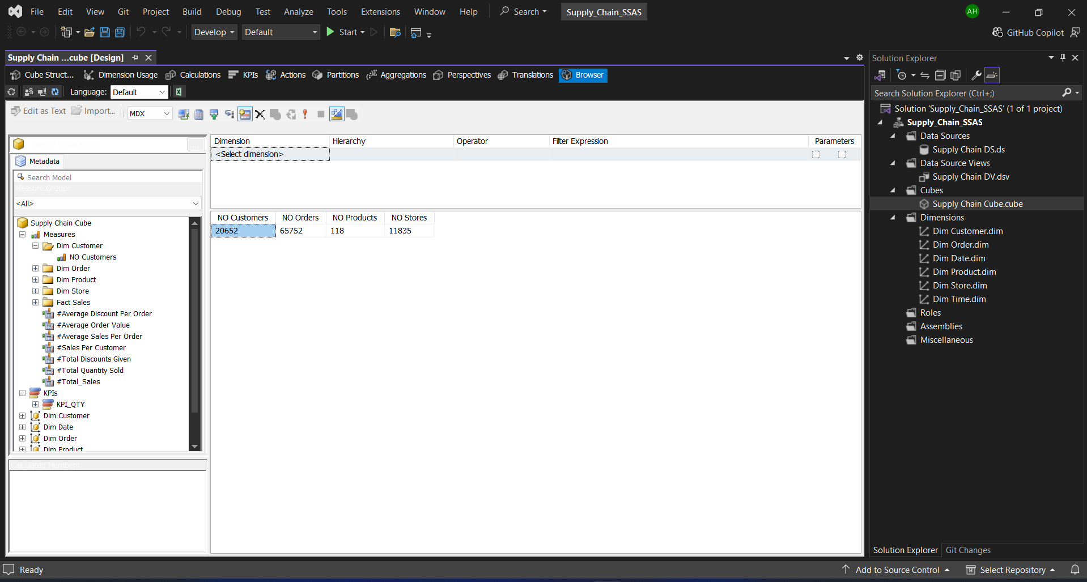
SSAS

Slide 30
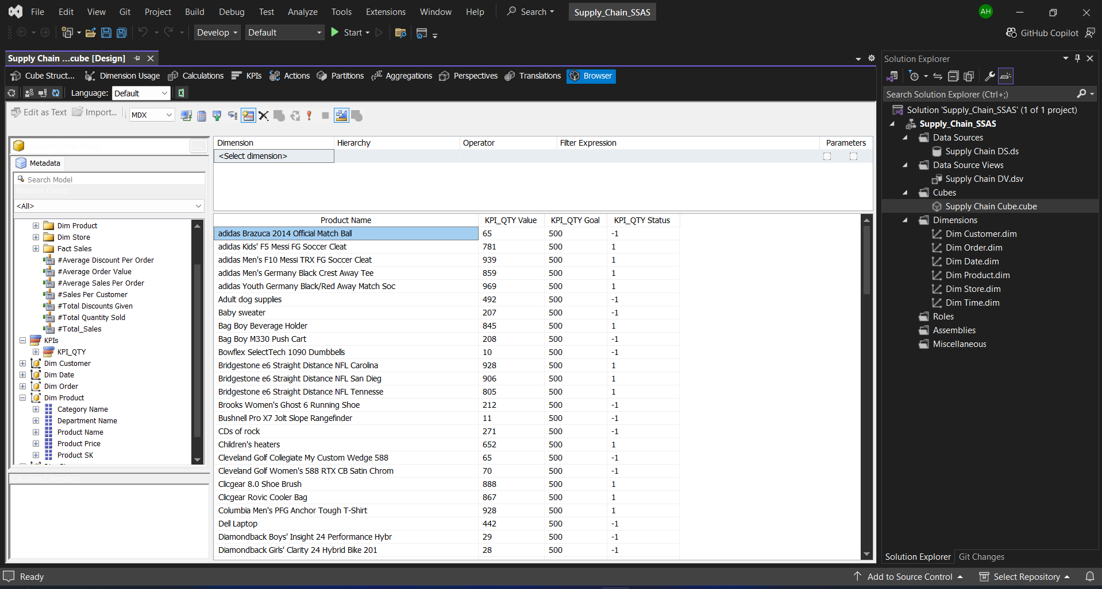
SSAS

Slide 31
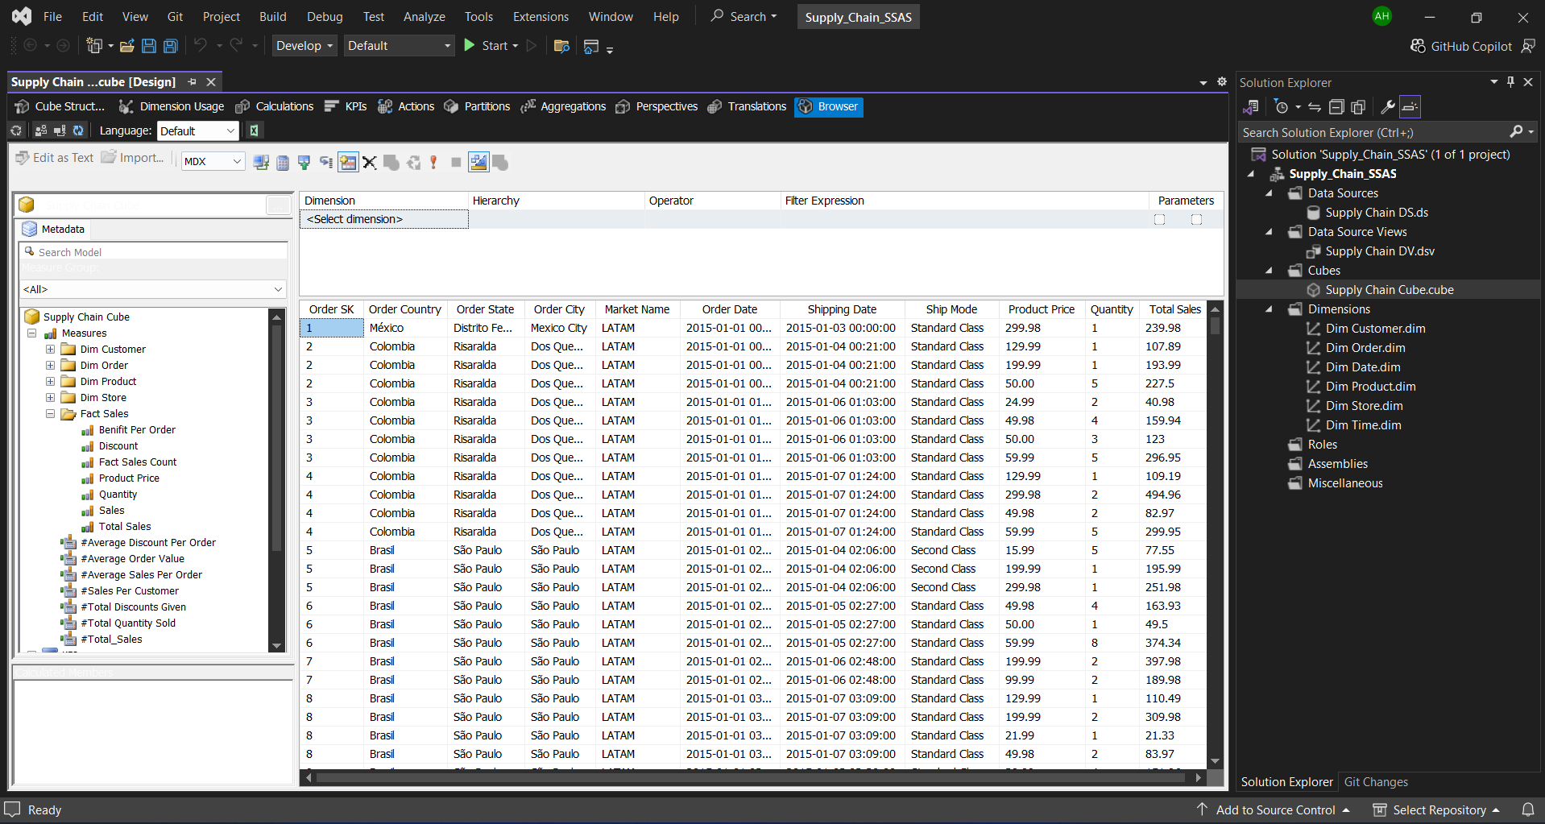
SSAS

Slide 32
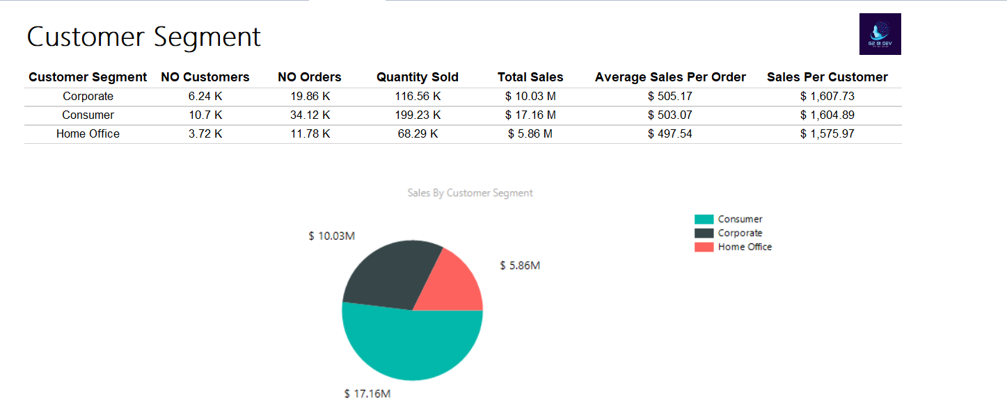
SSRS
Customer Report:

Slide 33
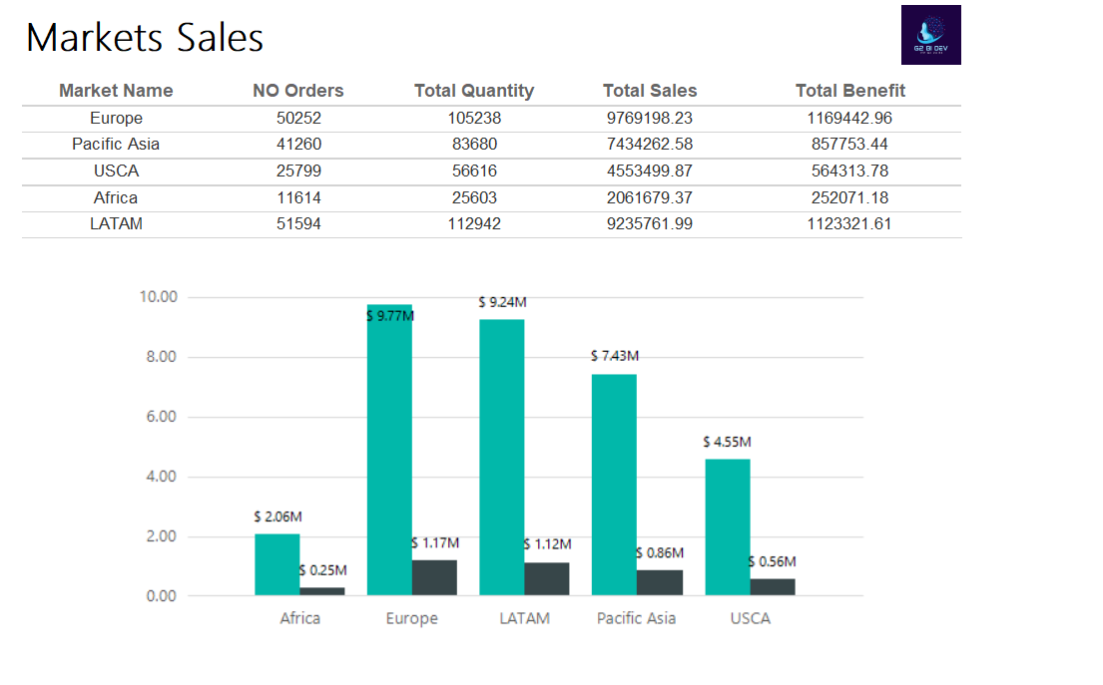
SSRS
Market Sales Report:

Slide 34
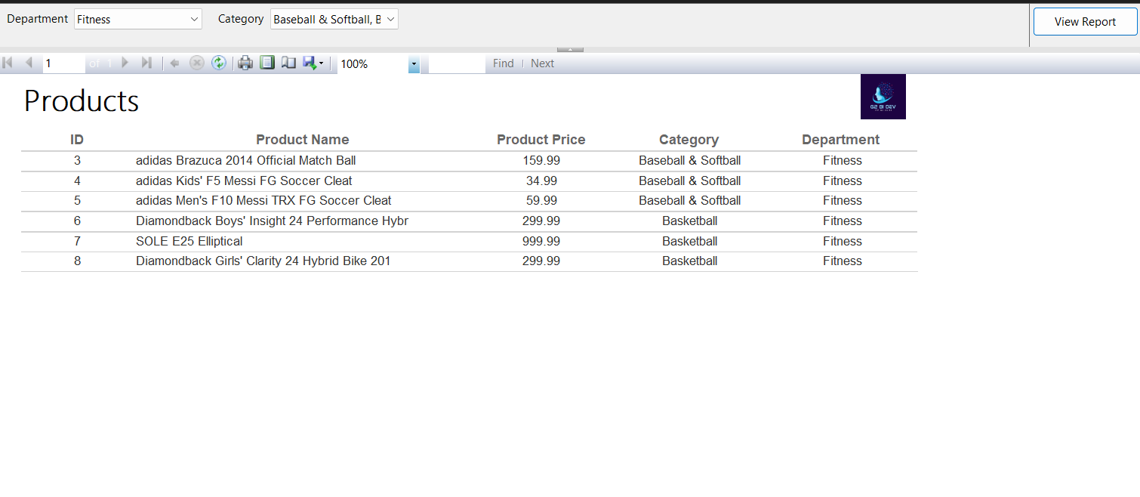
SSRS
Product Report:

Slide 35
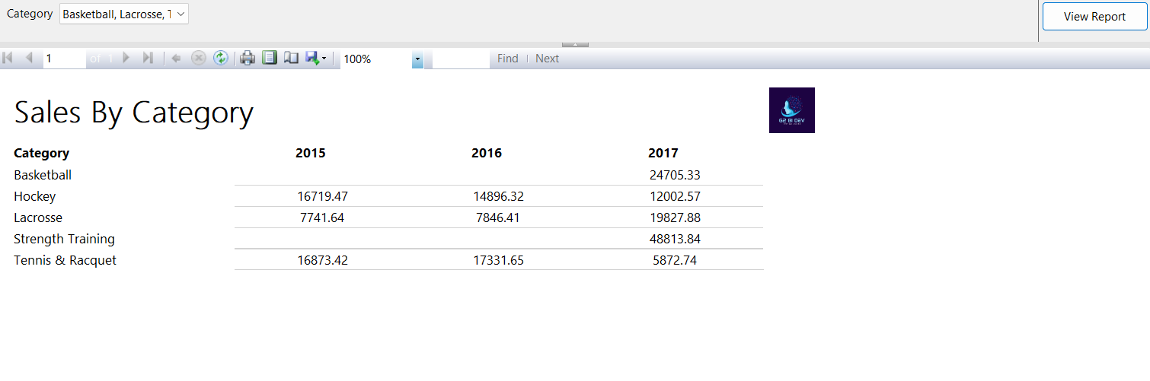
SSRS
Sales By Category Report :

Slide 36
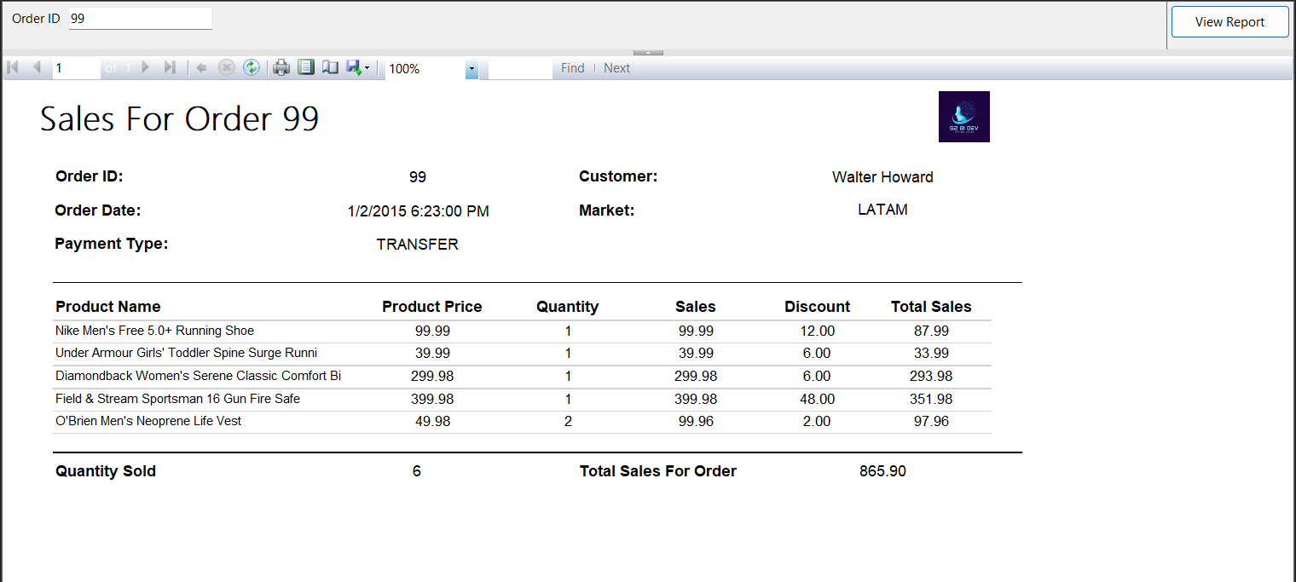
SSRS
Orders Report :

Slide 37
Visualization using Power BI
Visualization using Tableau
Visualization using Excel

Slide 38
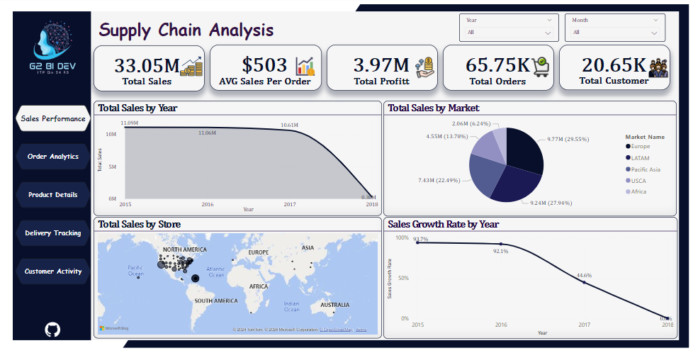
Visualization Using Power BI
Sales Dashboard:

Slide 39
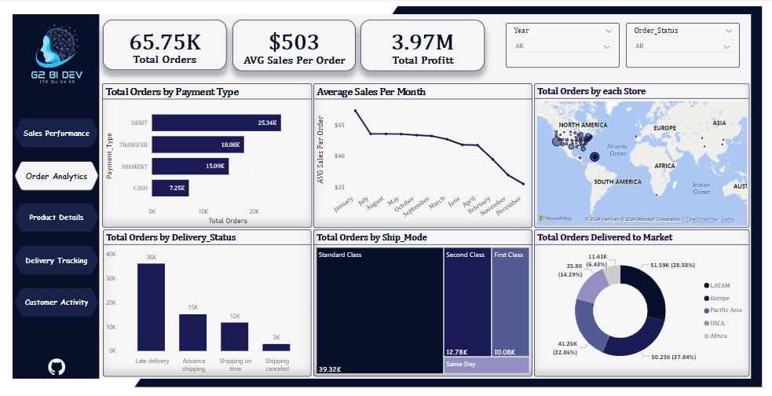
Visualization Using Power BI
Order Dashboard:

Slide 40
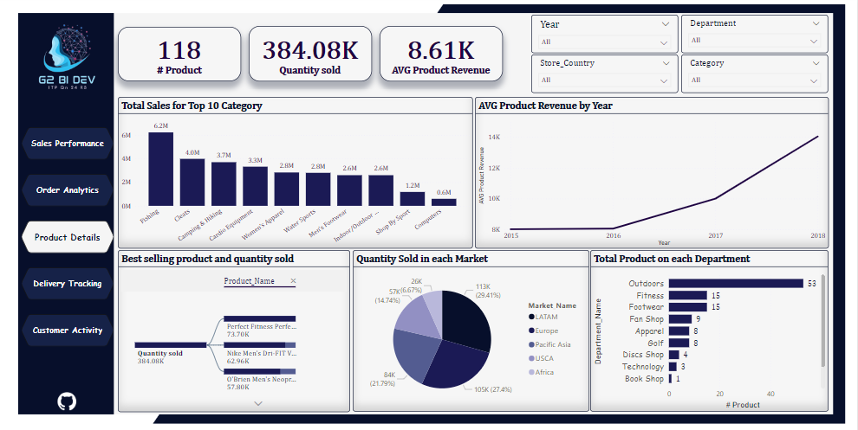
Visualization Using Power BI
Product Dashboard:

Slide 41
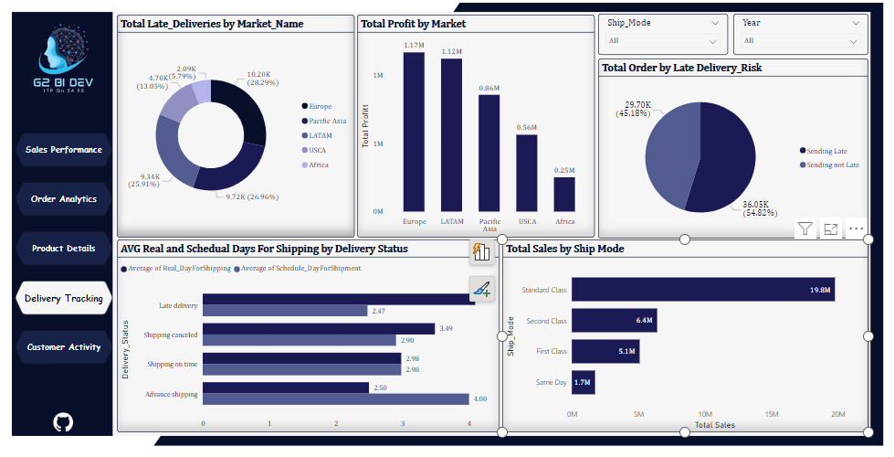
Visualization Using Power BI
Delivery Dashboard:

Slide 42
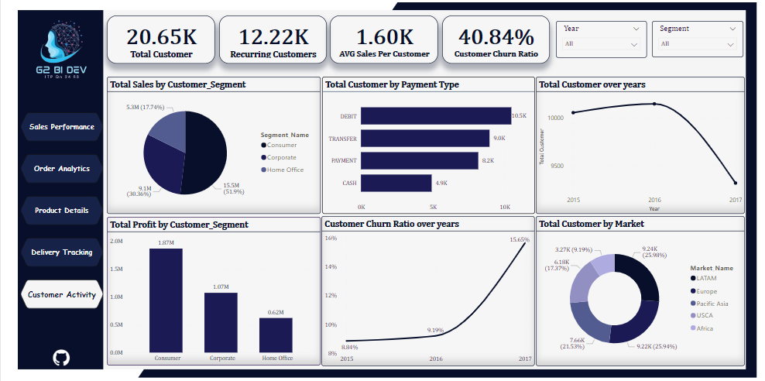
Visualization Using Power BI
Customer Dashboard:

Slide 43
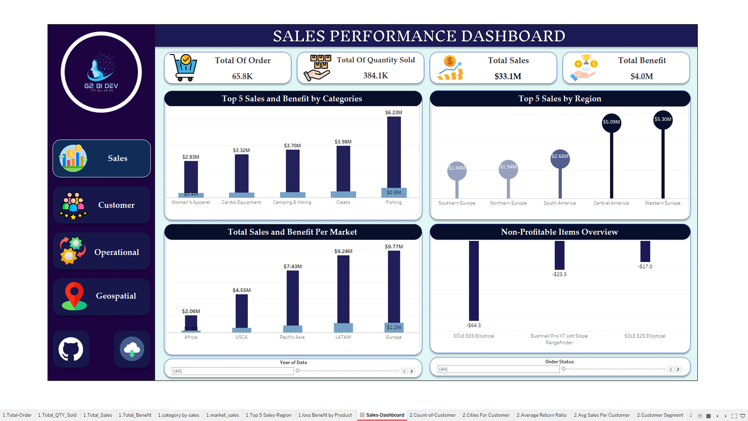
Visualization Using Tableau
Sales Dashboard:
YOUR PARAGRAPH TEXT

Slide 44
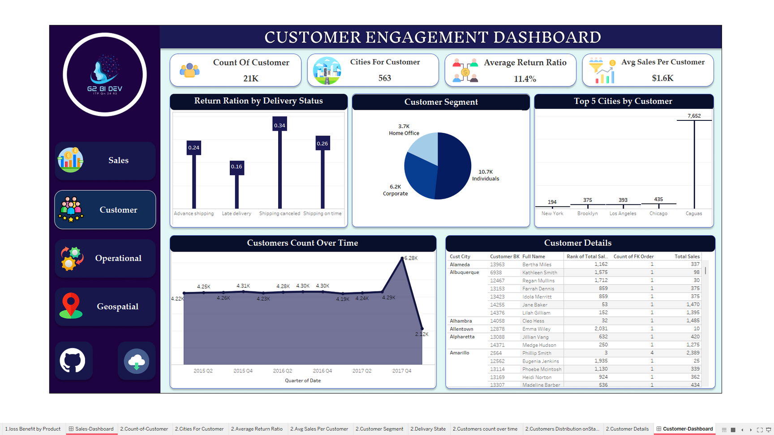
Visualization Using Tableau
Customer Dashboard:

Slide 45
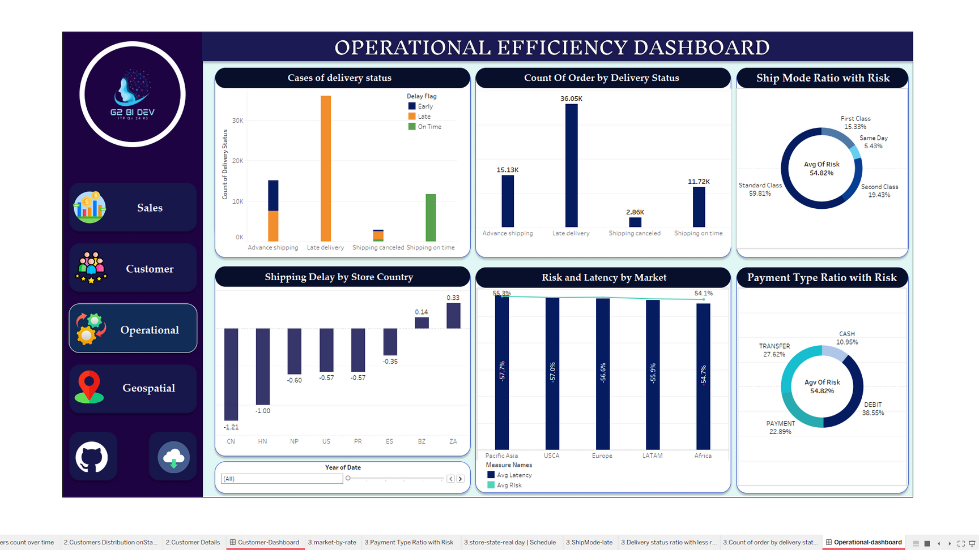
Visualization Using Tableau
Orerational Dashboard:

Slide 46
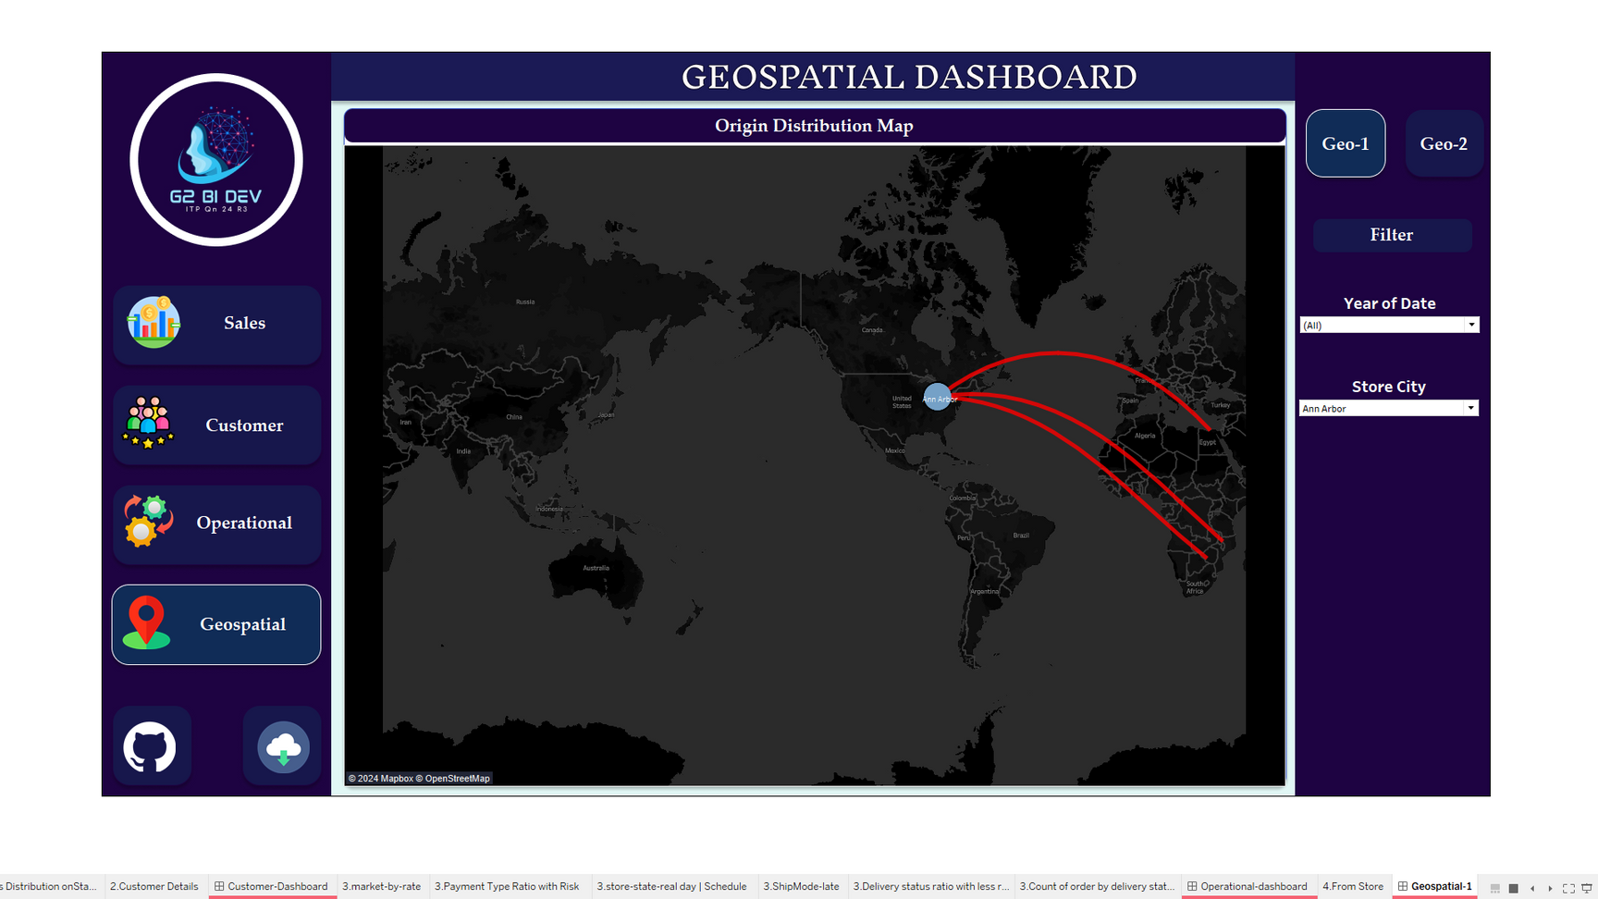
Visualization Using Tableau
Geospatial1 Dashboard:

Slide 47
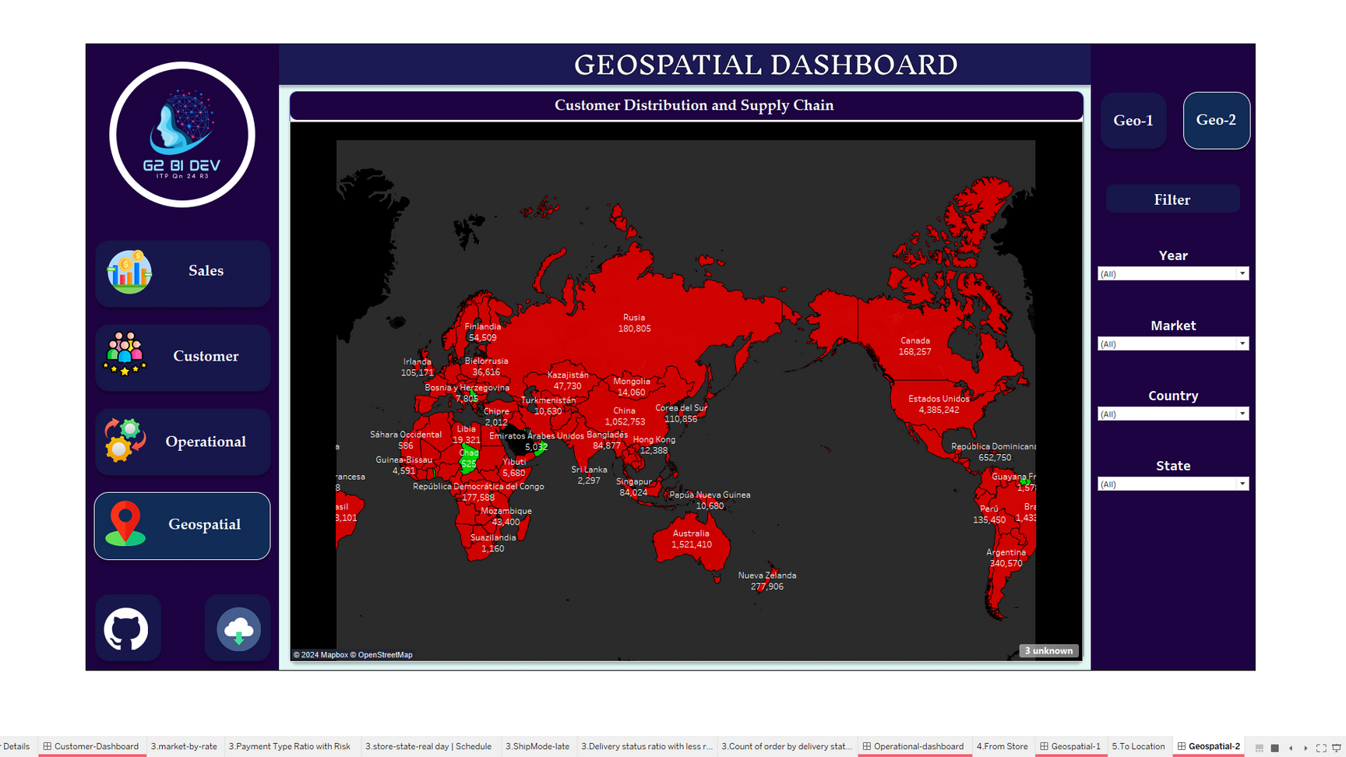
Visualization Using Tableau
Geospatial2 Dashboard:

Slide 48
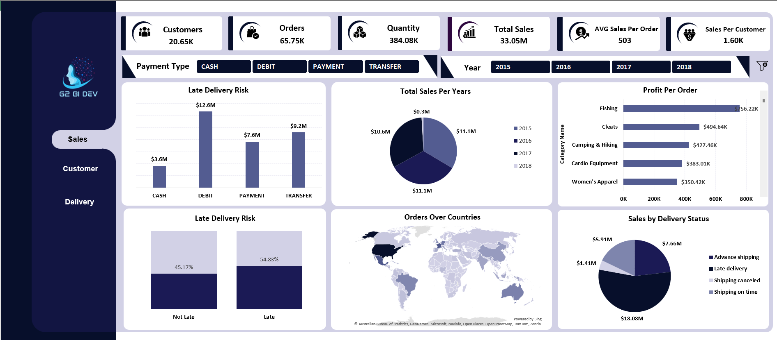
Visualization Using Excel
Sales Dashboard:

Slide 49
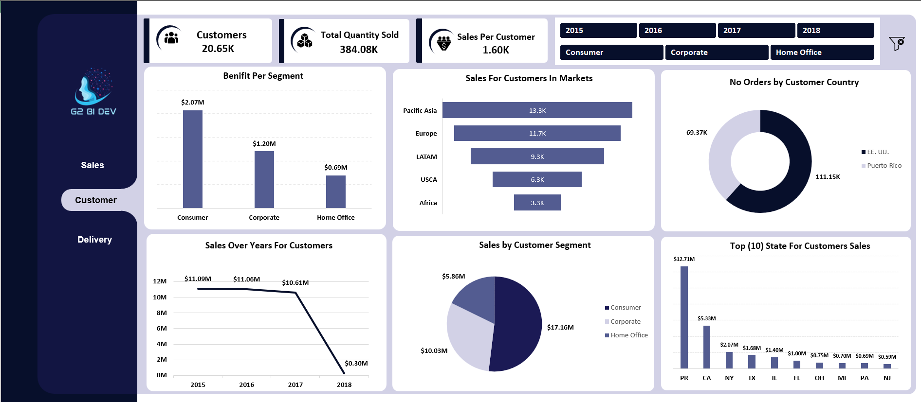
Visualization Using Excel
Customer Dashboard:

Slide 50
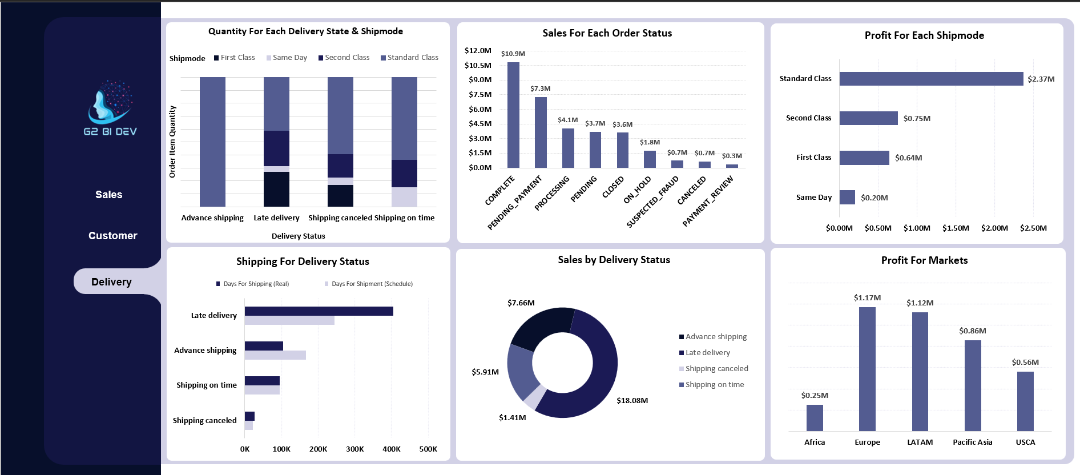
Visualization Using Excel
Delivery Dashboard:

Slide 51

Recommendation Actions
Profit for Markets:
The market with the lowest profit rate is in Africa =$0.25M
Action :
Consider offering special promotions or discounts to boost sales in less profitable areas.

Slide 52
Recommendation Actions
Total Orders by Delivery Status:
shows 36K orders are “Late Delivery” while only 12K orders are “Shipped on time.”
Action :
Increase Communication: Enhance communication with customers regarding their order status and expected delivery times, aiming to improve customer satisfaction .
•Streamline the shipping process to reduce the backlog of “Late Delivery” orders.

Slide 53
Recommendation Actions
Reduce Late Deliveries in Key Markets:
Europe has the highest percentage of late deliveries at 28.29%.
Action :
Implement stricter delivery timelines and consider alternative shipping methods to reduce late deliveries by at least 10%

Slide 54



